Slide 1
Greedy Algorithms
Marzieh Eskandari
NJIT

Slide 2
Greedy Approach
Main Idea: Take the best choice now, hope it leads to the global best.
Make a choice that looks best right now.
Check if the problem is solved.
Repeat until the solution is complete.

Slide 3
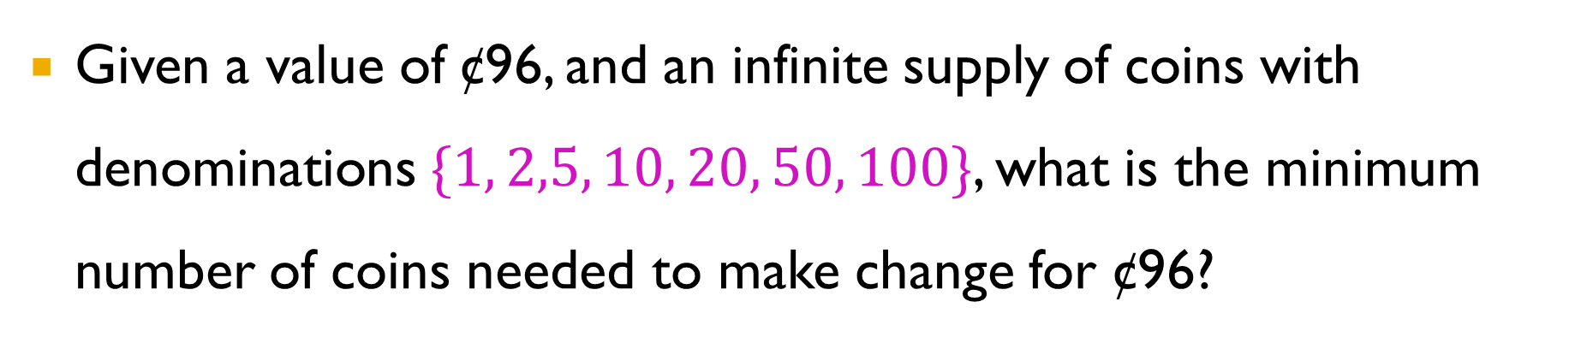
Introduction
Given a value of ¢96, and an infinite supply of coins with denominations $\{1, 2,5, 10, 20, 50, 100\}$, what is the minimum number of coins needed to make change for ¢96?
50
20
20
5
1
5

Slide 4
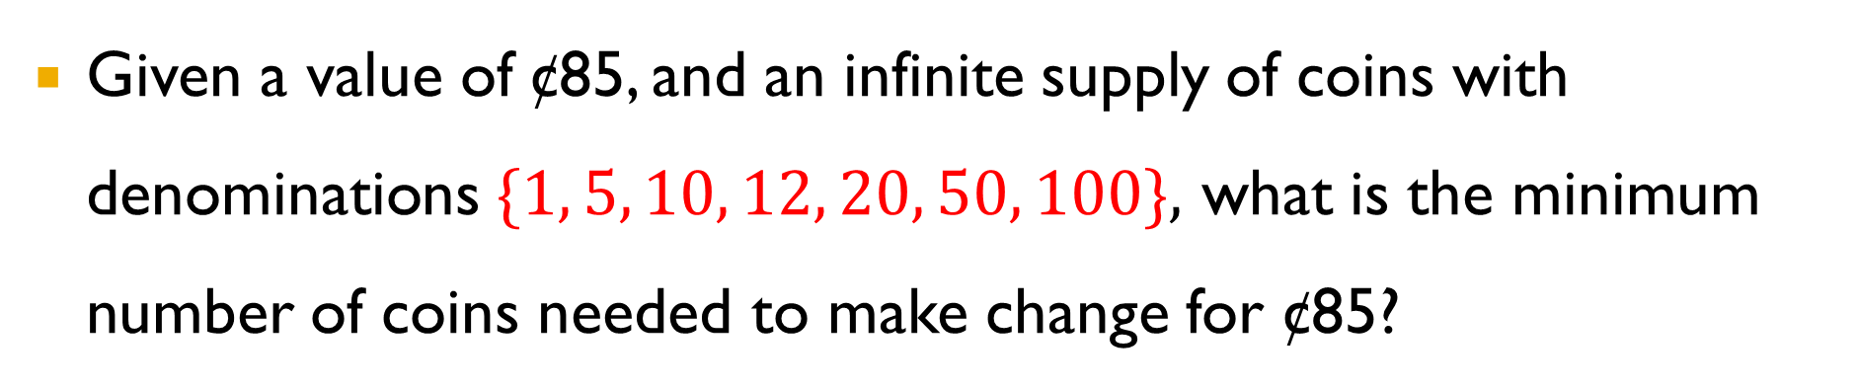
Introduction
Given a value of ¢85, and an infinite supply of coins with denominations $\{1, 5, 10, 12, 20, 50, 100\},$ what is the minimum number of coins needed to make change for ¢85?
6
50
20
12
1
1
1

Slide 5

Introduction
Given a value of ¢85, and an infinite supply of coins with denominations $\{1, 5, 10, 12, 20, 50, 100\}$, what is the minimum number of coins needed to make change for ¢85?
4
50
20
10
5

Slide 6
Greedy Approach
Sort C in decreasing order
S = ∅
while C is not empty:
if C.top <= V:
S.add(C.top)
V = V - C.top
if V == 0:
Print S
return
C.delete()

Slide 7





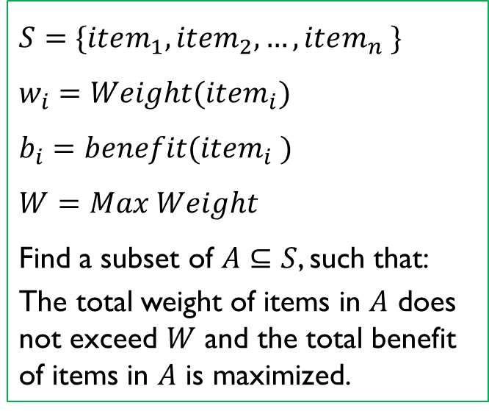
Knapsack problem
Item | Weight | Benefit
Camera | 10 | 320
Laptop | 20 | 400
Watch | 8 | 220
Guitar | 12 | 360
$$S=\{item_{1},item_{2},…,item_{n} \}$$
$$w_{i}=Weight(item_{i})$$
$$b_{i}=benefit(item_{i} )$$
$$W=Max Weight$$
Find a subset of $A⊆S$, such that:
The total weight of items in $A$ does not exceed $W$ and the total benefit of items in $A$ is maximized.
W=20 lbs
Notes:
The question is to select some items to maximize the benefit such that the total weight does not exceed a given value

Slide 8
0,1-Knapsack
Item | Weight | Benefit
Camera | 10 | 320
Laptop | 20 | 400
Watch | 8 | 220
Guitar | 12 | 360
2
4
benefit
Item | Weight | Benefit
Laptop | 20 | 400
Guitar | 12 | 360
Camera | 10 | 320
Watch | 8 | 220
W=20 lbs
3
1
Notes:
The question is to select some items to maximize the benefit such that the total weight does nit exceed a given value

Slide 9

0,1-Knapsack
Item | Weight | Benefit
Laptop | 20 | 400
Guitar | 12 | 360
Camera | 10 | 320
Watch | 8 | 220
W=-- lbs
Benefit=400
Notes:
The question is to select some items to maximize the benefit such that the total weight does nit exceed a given value

Slide 10
0,1-Knapsack
Item | Weight | Benefit
Camera | 10 | 320
Laptop | 20 | 400
Watch | 8 | 220
Guitar | 12 | 360
2
4
weight
Item | Weight | Benefit
Watch | 8 | 220
Camera | 10 | 320
Guitar | 12 | 360
Laptop | 20 | 400
W=20 lbs
3
1
Notes:
The question is to select some items to maximize the benefit such that the total weight does nit exceed a given value

Slide 11
0,1-Knapsack
Item | Weight | Benefit
Watch | 8 | 220
Camera | 10 | 320
Guitar | 12 | 360
Laptop | 20 | 400
W=2 lbs
Benefit=540
Notes:
The question is to select some items to maximize the benefit such that the total weight does nit exceed a given value

Slide 12
0,1-Knapsack
Item | Weight | Benefit
Camera | 10 | 320
Laptop | 20 | 400
Watch | 8 | 220
Guitar | 12 | 360
W=-- lbs
Benefit=580
Dynamic Programming?????

Slide 13
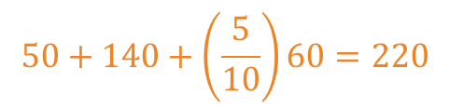
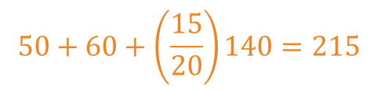

Fractional Knapsack
Item | Benefit
1 | 140
2 | 60
3 | 50
$$140+60=200$$
Item | Weight | benefit
1 | 20 | 140
2 | 10 | 60
3 | 5 | 50
Item | Weight
3 | 5
2 | 10
1 | 20
$$50+60+\left(\frac{15}{20}\right)140=215$$
W=30 lbs
Item | Benefit/Weight
3 | 10
1 | 7
2 | 6
$$50+140+\left(\frac{5}{10}\right)60=220$$
Notes:
Based on their value per pound: what

Slide 14
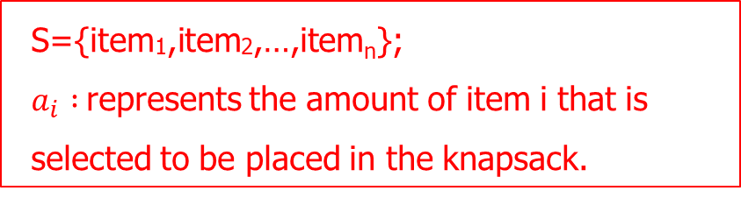
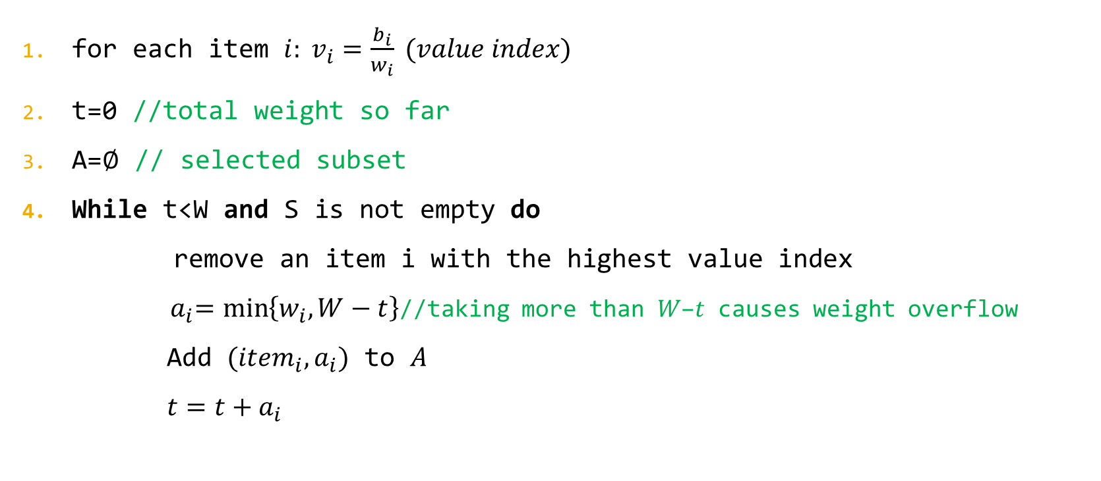
Algorithm
for each item $i: v_{i}=\frac{b_{i}}{w_{i}} (value index)$
t=0 //total weight so far
A=∅ // selected subset
While t<W and S is not empty do
remove an item i with the highest value index
${ a}_{i}=\min\left\{w_{i},W−t\right\}$//taking more than 𝑊−𝑡 causes weight overflow
Add $(item_{i}, a_{i})$ to $A$
$t=t+a_{i}$
S={item₁,item₂,…,item_{n}};
$a_{i} :$represents the amount of item i that is selected to be placed in the knapsack.

Slide 15
Text Compression and Huffman Coding
Another application of the greedy method is text compression.
In this problem, we are given a string X defined over some alphabet and we want to efficiently encode X into a small binary string Y (using only the characters 0 and 1).

Slide 16
Text Compression and Huffman Coding
Standard encoding schemes, such as the ASCII and Unicode systems, use fixed length binary strings to encode characters (with 7 bits in the ASCII system and 16 in the Unicode system).
For example: E: 69=1000101 Z: 90=1011010
For example, an English document whose length is 100 million characters would require at least 7 megabits to represent in ASCII and 16 megabits to represent in Unicode.
Notes:
UTF-8: A variable-length character encoding that stores Unicode characters as 1 to 4 bytes, backward-compatible with ASCII. It is Deterministic: the same character always has the same byte sequence: A: b'A' → [65] (1 byte)
é: b'\xc3\xa9' → [195, 169] (2 bytes)
你: b'\xe4\xbd\xa0' → [228, 189, 160] (3 bytes)
🚀: b'\xf0\x9f\x9a\x80' → [240, 159, 154, 128] (4 bytes)

Slide 17
Text Compression and Huffman Coding
Fixed-length code: Standard encoding schemes, such as the ASCII and Unicode systems, use fixed length binary strings to encode characters
10001010100011000101110111111000011111110110111011000110011011001001010001101100111111100011001011010000010110001101011100010100

Slide 18
Text Compression and Huffman Coding
Fixed-length code: Standard encoding schemes, such as the ASCII and Unicode systems, use fixed length binary strings to encode characters
10001010100011000101110111111000011111110110111011000110011011001001010001101100111111100011001011010000010110001101011100010100

Slide 19
Text Compression and Huffman Coding
This is a waste of bits, however, since there are some characters that are hardly ever used and others, like the letter “e”, that is used so often that it is shame to be using the same number of bits for it as the seldomly used characters.
Variable-length code: In this scheme, the codes for various characters are allowed to have different lengths. Ideally, we would like the most-frequently used characters to use the fewest number of bits, and the least-frequently used characters to use the most.
Notes:
some characters that are hardly ever used and some are used so often

Slide 20
Text Compression and Huffman Coding
We insist that no code word in our scheme is a prefix of any other code word in our scheme. Such an encoding is a prefix code.
The advantage of using such a prefix code is that decoding can be accomplished by using the greedy strategy of processing the bits of Y in order, repeatedly matching bits to the first code word they represent.

Slide 21
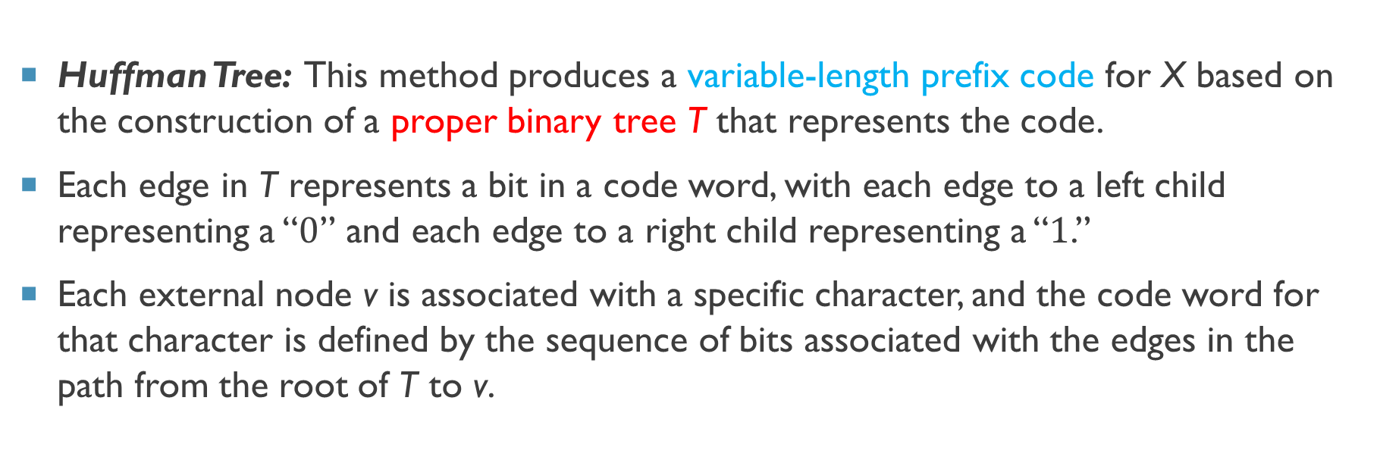
Huffman Coding
Huffman Tree: This method produces a variable-length prefix code for X based on the construction of a proper binary tree T that represents the code.
Each edge in T represents a bit in a code word, with each edge to a left child representing a “$0$” and each edge to a right child representing a “$1$.”
Each external node v is associated with a specific character, and the code word for that character is defined by the sequence of bits associated with the edges in the path from the root of T to v.

Slide 22
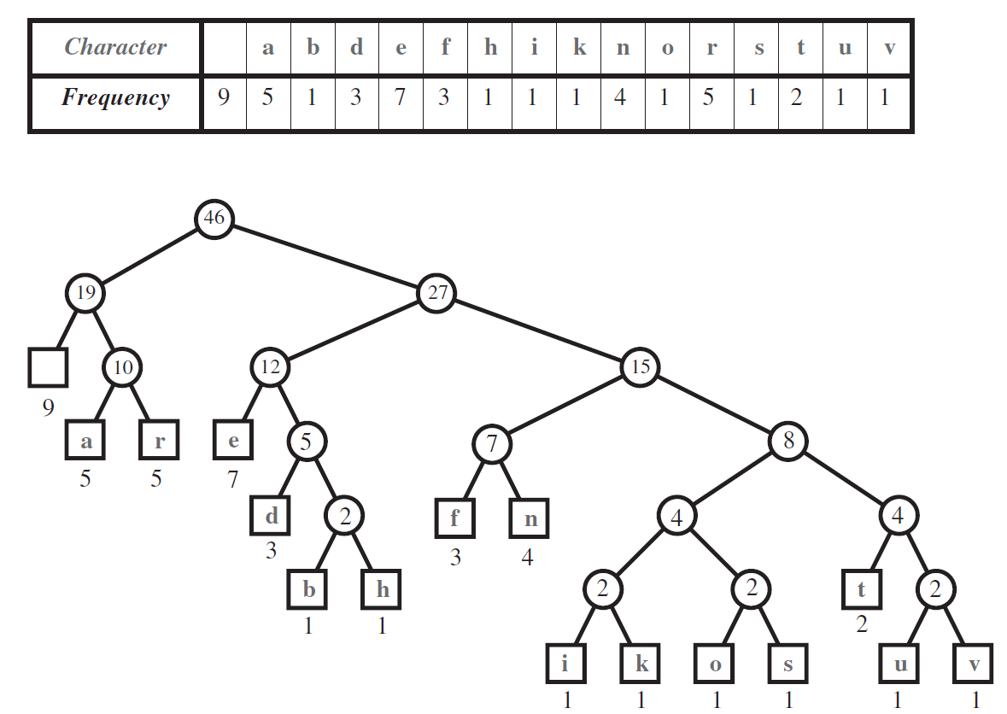
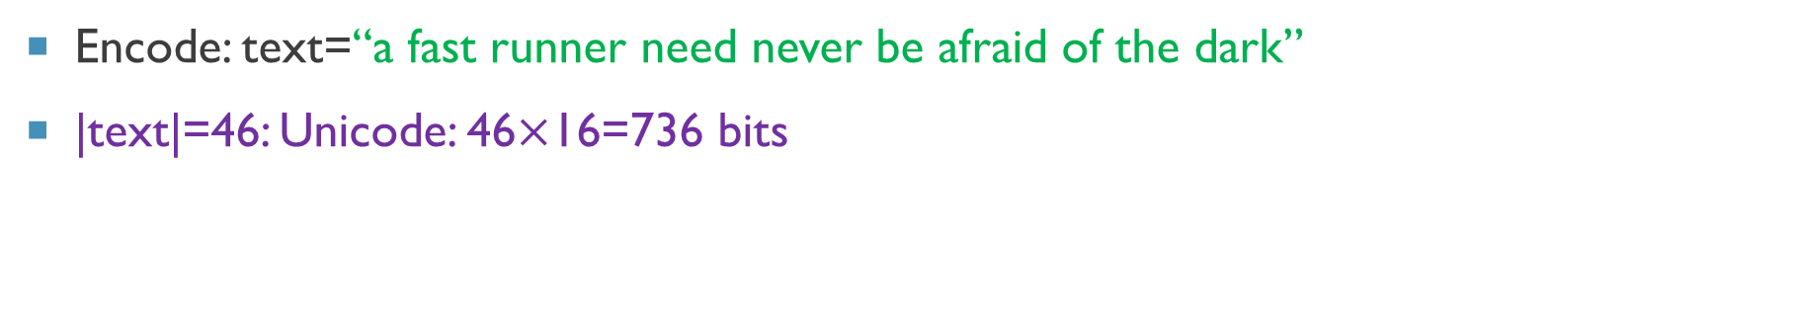
Example
Encode: text=“a fast runner need never be afraid of the dark”
|text|=46: Unicode: 46$×$16=736 bits

Slide 23
Example

Slide 24
Example
0
1
0
1
0
1
0
1
1
1
0
0
0
1
0
0
1
1
0
1
0
1
0
1
0
1
0
1
0
1

Slide 25
Example
 | Code
 | 00
a | 010
r | 011
e | 100
d | 1010
b | 10110
h | 10111
f | 1100
n | 1101
i | 111000
k | 111001
o | 111010
s | 111011
t | 11110
u | 111110
v | 111111
0
1
0
1
0
1
0
1
1
1
0
0
0
1
0
0
1
1
0
1
0
1
0
1
0
1
0
1
0
1

Slide 26
Example
 | Code
 | 00
a | 010
r | 011
e | 100
d | 1010
b | 10110
h | 10111
f | 1100
n | 1101
i | 111000
k | 111001
o | 111010
s | 111011
t | 11110
u | 111110
v | 111111
t=“a fast runner need never be afraid of the dark”
e=010001100010111011111100001111111011011101100
01100110110010010100011011001111111000110010110
10000010110001101011100010100011101011000011110
10111100001010010011111001
|t|=736 bits
|e|=174 bits

Slide 27
Questions!
How to decode?
Why Huffman coding is a prefix code?
Why Huffman coding is a variable-length?
How to make the tree from table of codewords?

Slide 28
Example
character | a | h | o | s | r | m
frequencies | 3 | 4 | 1 | 2 | 1 | 2
character | o | r | m | s | a | h
frequencies | 1 | 1 | 2 | 2 | 3 | 4

Slide 29
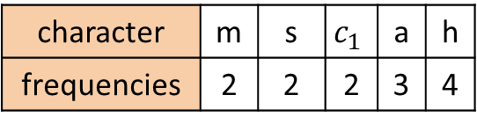

Example
character | o | r | m | s | a | h
frequencies | 1 | 1 | 2 | 2 | 3 | 4
character | m | s | $$c_{1}$$ | a | h
frequencies | 2 | 2 | 2 | 3 | 4
$${ c}_{1}$$
2
o
r
1
1

Slide 30
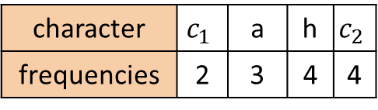

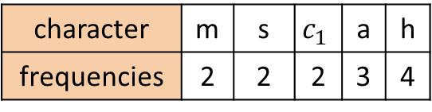
Example
character | m | s | $$c_{1}$$ | a | h
frequencies | 2 | 2 | 2 | 3 | 4
character | $$c_{1}$$ | a | h | $$c_{2}$$
frequencies | 2 | 3 | 4 | 4
$${ c}_{2}$$
4
$${ c}_{1}$$
2
m
s
o
r
2
2
1
1

Slide 31
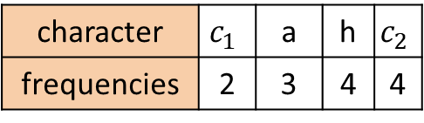
Example
character | $$c_{1}$$ | a | h | $$c_{2}$$
frequencies | 2 | 3 | 4 | 4
$${ c}_{2}$$
4
$${ c}_{1}$$
2
a
3
m
s
o
r
2
2
1
1

Slide 32

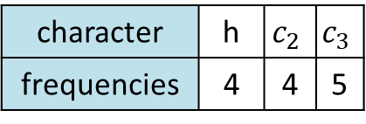
Example
character | $$c_{1}$$ | a | h | $$c_{2}$$
frequencies | 2 | 3 | 4 | 4
character | h | $$c_{2}$$ | $$c_{3}$$
frequencies | 4 | 4 | 5
$${ c}_{3}$$
5
$${ c}_{2}$$
4
$${ c}_{1}$$
2
a
3
m
s
o
r
2
2
1
1

Slide 33
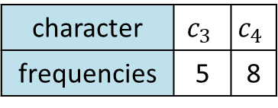
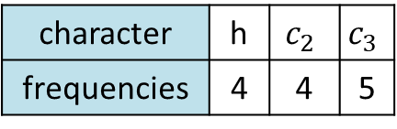

Example
character | h | $$c_{2}$$ | $$c_{3}$$
frequencies | 4 | 4 | 5
character | $$c_{3}$$ | $$c_{4}$$
frequencies | 5 | 8
$${ c}_{4}$$
8
$${ c}_{3}$$
5
$${ c}_{2}$$
4
h
$${ c}_{1}$$
2
a
4
3
m
s
o
r
2
2
1
1

Slide 34
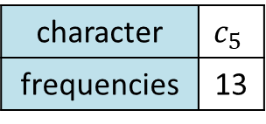
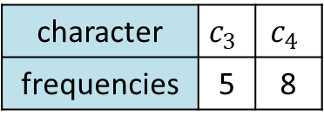

Example
character | $$c_{3}$$ | $$c_{4}$$
frequencies | 5 | 8
character | $$c_{5}$$
frequencies | 13
$${ c}_{5}$$
13
$${ c}_{4}$$
8
$${ c}_{3}$$
5
$${ c}_{2}$$
4
h
$${ c}_{1}$$
2
a
4
3
m
s
o
r
2
2
1
1

Slide 35
Construct a Huffman tree
Input: A set, C, of d characters, each with a given frequency, f(c)
Output: a Huffman tree

Slide 36
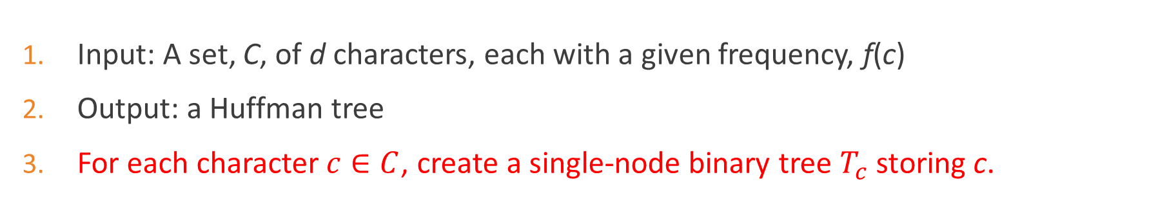
Construct a Huffman tree
Input: A set, C, of d characters, each with a given frequency, f(c)
Output: a Huffman tree
For each character$c∈C$, create a single-node binary tree $T_{c}$ storing c.
 |  | a |  | r |  | e |  | d |  | b |  | h |  | f |  | n |  | i |  | k |  | o |  | s |  | t |  | u |  | v

Slide 37
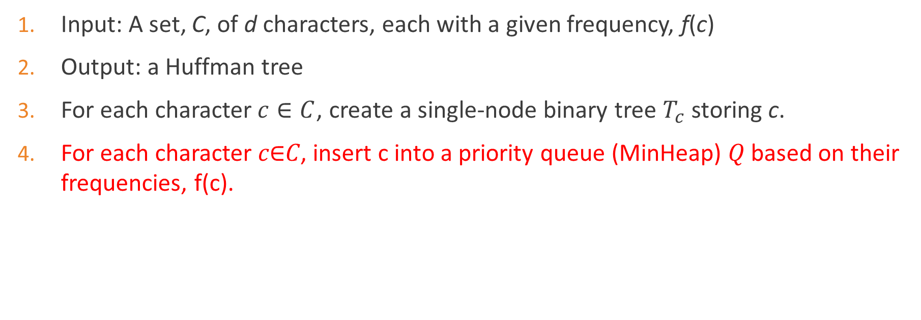
Construct a Huffman tree
Input: A set, C, of d characters, each with a given frequency, f(c)
Output: a Huffman tree
For each character$c∈C$, create a single-node binary tree $T_{c}$ storing c.
For each character 𝑐∈𝐶, insert c into a priority queue (MinHeap) 𝑄 based on their frequencies, f(c).
u | v | o | s | i | k | b | h | d | e | n | r | a | f | t
1 | 1 | 1 | 1 | 1 | 1 | 1 | 1 | 3 | 7 | 4 | 5 | 5 | 3 | 2 | 9

Slide 38
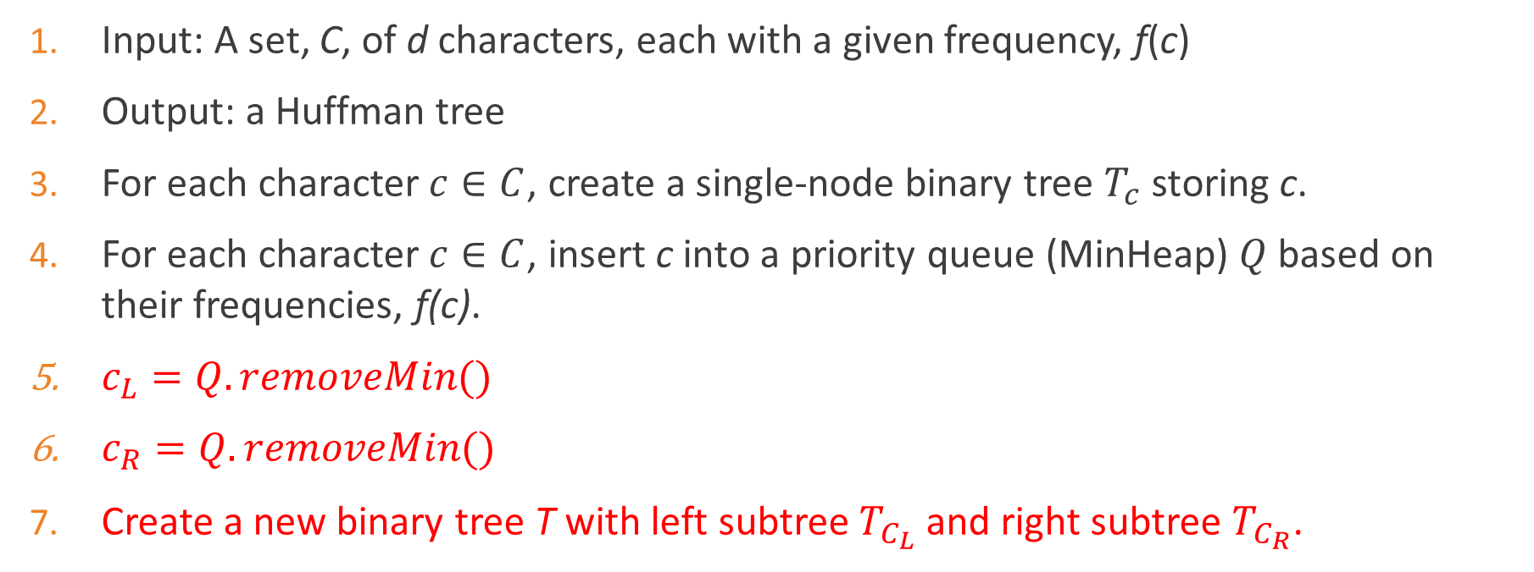
Construct a Huffman tree
Input: A set, C, of d characters, each with a given frequency, f(c)
Output: a Huffman tree
For each character$c∈C$, create a single-node binary tree $T_{c}$ storing c.
For each character$c∈C$, insert c into a priority queue (MinHeap) $Q$ based on their frequencies, f(c).
$c_{L}=Q.removeMin()$
$c_{R}=Q.removeMin()$
Create a new binary tree T with left subtree $T_{C_{L}}$ and right subtree $T_{C_{R}}$.

Slide 39
Construct a Huffman tree
u | v | o | s | i | k | b | h | d | e | n | r | a | f | t
1 | 1 | 1 | 1 | 1 | 1 | 1 | 1 | 3 | 7 | 4 | 5 | 5 | 3 | 2 | 9

Slide 40

Construct a Huffman tree
u | v | o | s | i | k | b | h | d | e | n | r | a | f | t
 | 1 | 1 | 1 | 1 | 1 | 1 | 1 | 3 | 7 | 4 | 5 | 5 | 3 | 2 | 9
$$c_{L}=u$$

Slide 41


Construct a Huffman tree
u | v | o | s | i | k | t | b | h |  | d | e | n | r | a | f
 |  | 1 | 1 | 1 | 1 | 2 | 1 | 1 | 9 | 3 | 7 | 4 | 5 | 5 | 3
$$c_{L}=u$$
$$c_{R}=v$$

Slide 42



Construct a Huffman tree
u | v | o | s | i | k | t | b | h |  | d | e | n | r | a | f
 |  | 1 | 1 | 1 | 1 | 2 | 1 | 1 | 9 | 3 | 7 | 4 | 5 | 5 | 3
$${ c}_{1}$$
2
u
v
$T_{u}$
$T_{v}$

Slide 43
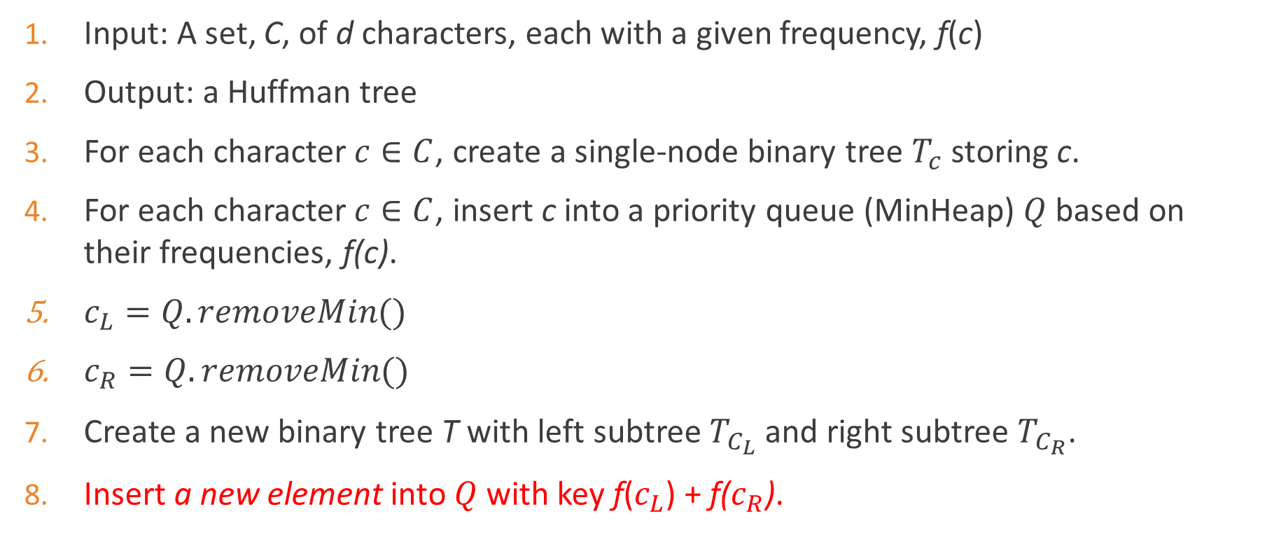
Construct a Huffman tree
Input: A set, C, of d characters, each with a given frequency, f(c)
Output: a Huffman tree
For each character$c∈C$, create a single-node binary tree $T_{c}$ storing c.
For each character$c∈C$, insert c into a priority queue (MinHeap) $Q$ based on their frequencies, f(c).
$c_{L}=Q.removeMin()$
$c_{R}=Q.removeMin()$
Create a new binary tree T with left subtree $T_{C_{L}}$ and right subtree $T_{C_{R}}$.
Insert a new element into $Q$ with key f($c_{L}$) + f($c_{R}$).

Slide 44
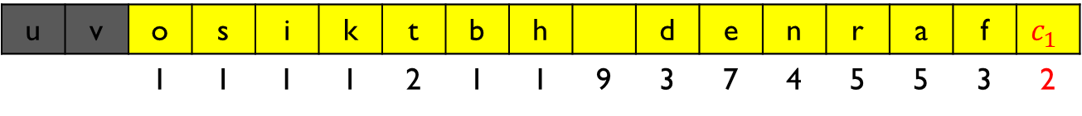
Construct a Huffman tree
u | v | o | s | i | k | t | b | h |  | d | e | n | r | a | f | $$c_{1}$$
 |  | 1 | 1 | 1 | 1 | 2 | 1 | 1 | 9 | 3 | 7 | 4 | 5 | 5 | 3 | 2
$${ c}_{1}$$
2
u
v
$T_{u}$
$T_{v}$

Slide 45









Construct a Huffman tree
u | v | o | s | i | k | b | h | t | $$c_{1}$$ | $$c_{3}$$ | f | n | $$c_{2}$$ | a |  | $$d$$ | e | r | $$c_{4}$$
 |  |  |  |  |  |  |  | 2 | 2 | 2 | 3 | 4 | 2 | 5 | 9 | 3 | 7 | 5 | 2
$${ c}_{4}$$
2
$${ c}_{3}$$
2
$${ c}_{2}$$
2
$${ c}_{1}$$
2
b
h
i
k
o
s
u
v
$T_{u}$
$T_{v}$
$T_{u}$
$T_{v}$
$T_{u}$
$T_{v}$
$T_{u}$
$T_{v}$

Slide 46





Construct a Huffman tree
u | v | o | s | i | k | b | h | t | $$c_{1}$$ | $$c_{3}$$ | f | $$c_{2}$$ | $$d$$ | n | $$c_{4}$$ | a |  | r | e | $$c_{5}$$
 |  |  |  |  |  |  |  |  |  | 2 | 3 | 2 | 3 | 4 | 2 | 5 | 9 | 5 | 7 | 4
$${ c}_{5}$$
4
$${ c}_{4}$$
2
$${ c}_{3}$$
2
$${ c}_{2}$$
2
t
$${ c}_{1}$$
2
$T_{t}$
b
h
i
k
o
s
u
v
$T_{u}$
$T_{v}$
$T_{u}$
$T_{v}$
$T_{u}$
$T_{v}$
$T_{u}$
$T_{v}$

Slide 47
Example

Slide 48
Any Question??
Have a nice day!

